Slide 1
DIVISION OF INFORMATION TECHNOLOGY SERVICES
FIJI NATIONAL UNIVERSITY
IT SERVICES
STUDENT ORIENTATION
2025

Slide 2
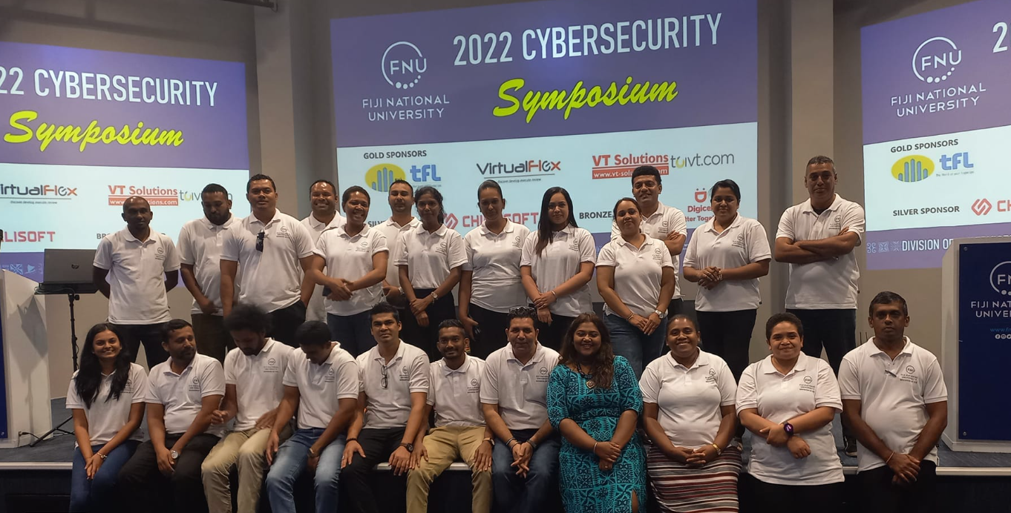
INTRODUCTION
IT Services manages the University's IT infrastructure and offers a range of facilities and services to assist staff and students with their IT-related needs.
It supports the university in its move towards blended/ online delivery, retaining an engaging on campus student experience, contributing to student retention, extending our e-Research capability and supporting business operations.

Slide 3
Table of Content
Slide
IT Student Services……………………………………………………………………………….. 4
Banner Self Service ………………………………………………………………………………. 5
Banner Self Service – Guide ………………………………………………………….……… 6
Moodle Services …………………………………………………………………………………... 15
Student Password Request …………………………………………………………………... 18
Student Password – How to Change ……………………………………………………… 19
Student Wi-Fi Request ……………………………………………………………………………. 21
Student Email Services ………………………………………………………………………….. 22
Other IT Related Issues & Assistance ……………………………………………………… 23
General Purpose ITS Labs ………………………………………………………………………. 24
IT Lab Rules …………………………………………………………………………………………… 25
Contact Us …………………………………………………………………………………………….. 26
Moodle Guide
Student Email Password Registration
Student Email Password Reset – Guide

Slide 4
IT STUDENT SERVICES
Student Services
Banner Self Service
Moodle Services
Student Wi-Fi Request
Student Email
Student Password Request
Other Student IT Related Issues & Assistance

Slide 5
Banner Self Service
Banner ERP system integrates core functions and processes throughout the various divisions within the university. One of the main applications is Banner Student.
Who Can Access Banner Student?
All registered students can access Banner Student with their valid login credentials provided by ITS.
New students need to provide their offer letters and continuing students need to provide their Student ID card to their nearest IT office.
Services provided on Banner Student
My FNU student Self Service allows students to perform majority of the University tasks all in one place, such as:
View current profile information records
Search the course catalog, register for courses and view your class schedule (timetable)
View final grades
View Student financial account information
View programme structures

Slide 6
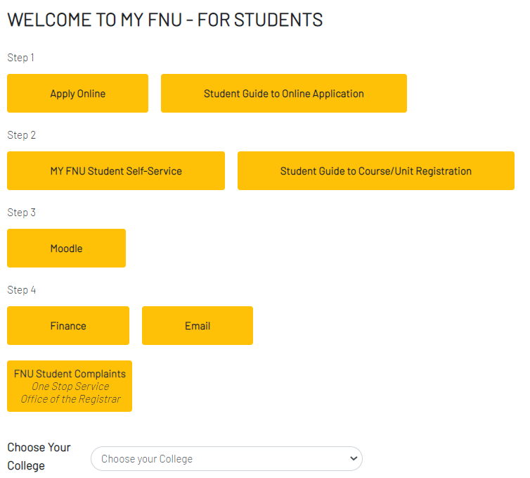
Banner Self Service - Guide
Students can access the Banner login page from www.fnu.ac.fj / student

Slide 7
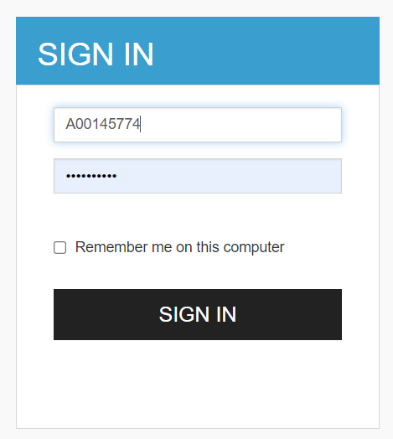
Banner Self Service - Guide
Students can click on the below link for Banner Login
https://self-service.fnu.ac.fj/StudentSelfService/

Slide 8
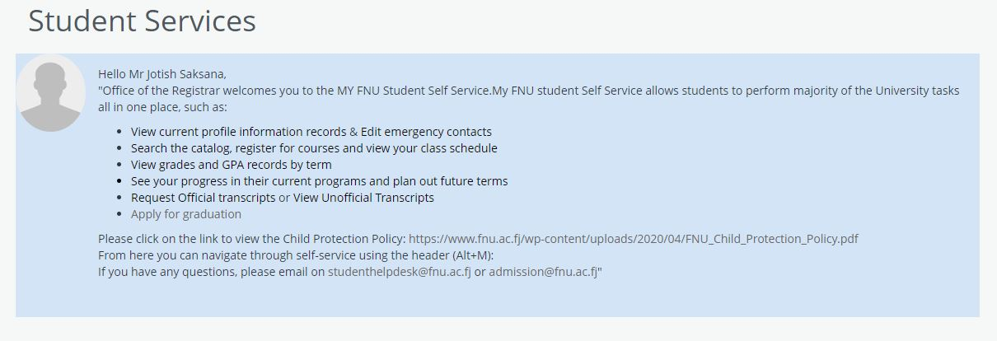
Banner Self Service - Guide
Welcome Screen

Slide 9
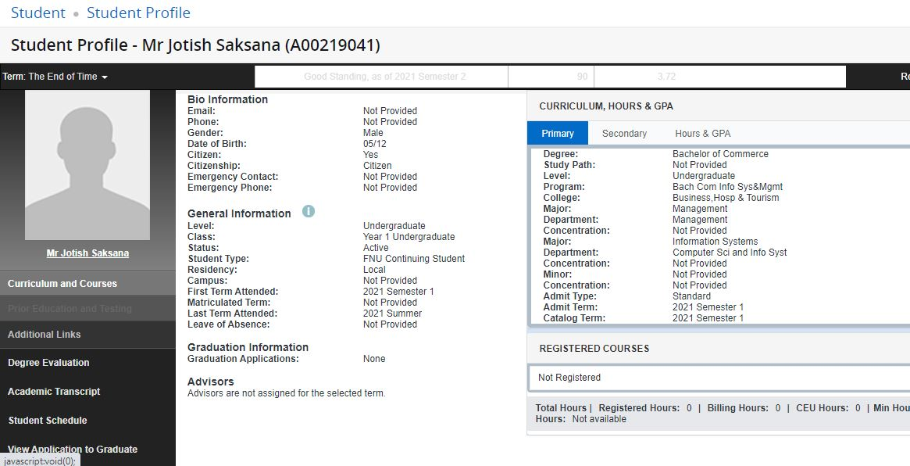
Banner Self Service - Guide

Slide 10
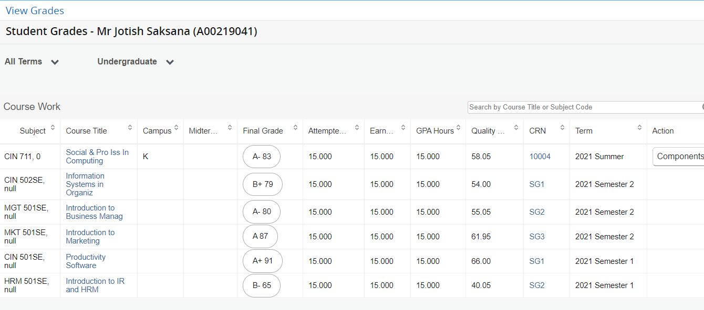
Banner Self Service - Guide

Slide 11
Banner Self Service - Guide

Slide 12
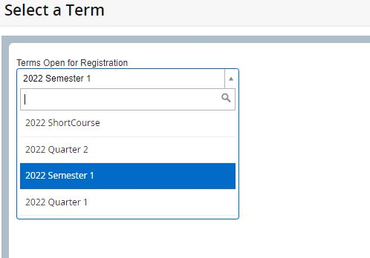
Banner Self Service - Guide

Slide 13
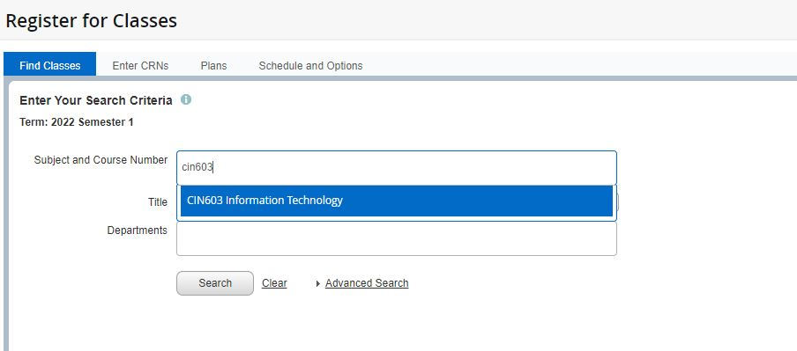
Banner Self Service - Guide

Slide 14
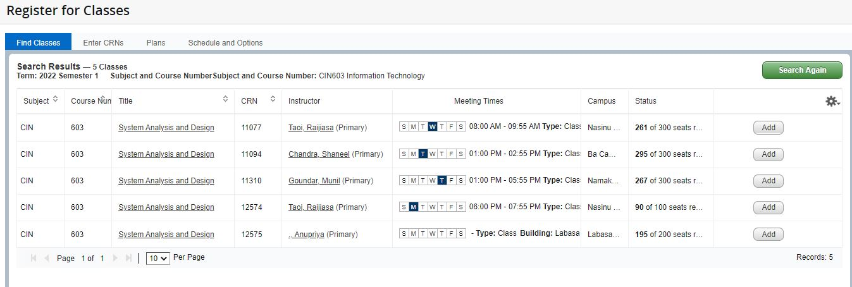
Banner Self Service - Guide

Slide 15
Moodle Services
Moodle is a web-based E-Learning environment that allows you to access your course materials online and make use of several useful built-in facilities to enhance your learning experience.
It brings the dynamics of a classroom environment to the Internet. It allows teachers and students to interact in a ‘virtual classroom’ in much the same way as in a standard classroom. The difference is that it can be done from any place in the world, at any time and with the resources of the Internet as support.
Enrollment in the student management system is required before access to your Moodle course is enabled.
Most FNU courses have a Moodle course page. When you enrol and access Moodle, you will see your courses listed. Moodle course pages offer lecture notes, presentations, and a forum for course announcements from your lecturer. Other course pages also offer quizzes to test your knowledge, discussion forums, chat sessions, and other useful resources to support your learning.

Slide 16
Moodle Services
Students can access the Moodle login page from www.fnu.ac.fj / student

Slide 17
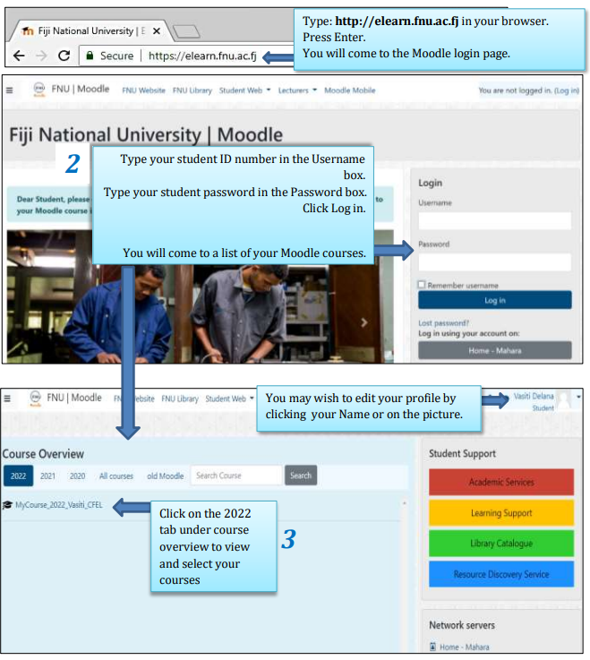
Moodle Services
Students can access Moodle through a smart device such as a mobile phone, tablet, or laptop with an internet connection.
Moodle can be accessed from
https://elearn.fnu.ac.fj/ or through FNU Website
Link to Moodle Guide
Students are advised to use their student Gmail account while activating their Moodle account.

Slide 18
Student Password Request
Students can obtain passwords by either visiting their nearest ITS office, GP Lab or by emailing itservicedesk@fnu.ac.fj
The following passwords are issued to students:
Student Banner password:
Used to login to:
Computers in labs
MY FNU Student Self Service
Moodle
Student Email password: Used to login to Email Services via Gmail. Students are encouraged to check their Student email accounts regularly as all university updates are broadcasted to this email address. All university correspondence should be sent using the official Student email account.
Cross Credit password: Used to make cross credit applications online.
Student will need to present their offer letters or FNU student ID cards at their nearest ITS office to obtain the above passwords.
Note
If you change your Windows Login password, your Moodle login password will also change.

Slide 19
Student Wi-Fi Request
Internet –labs are open at all campuses for students to access internet for research and academic related work. Wireless internet access is also available on all campuses.
Contact the nearest ITS office to have Wi-Fi configured to your laptop/smart devices.
With more than 90% Wi-Fi coverage on all FNU campuses, students are able to enjoy free and fast internet connection.

Slide 20
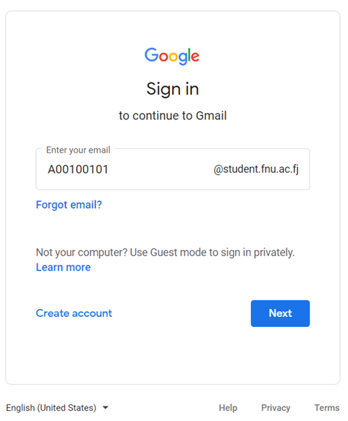
Student Email Services
Students can access the Email page from www.fnu.ac.fj / student
Guide for Student Email

Slide 21
Other IT Related Issues & Assistance
Other services provided to Students
Students can visit the nearest ITS office for the assistance in relation to:
Wi-Fi configuration on their personal devices.
Advise on device purchases eg. Laptops
Assist with in-depth computing issues with regards to student devices.
Enquiries on Moodle units not showing on the E-Learning platform.
Assistance on Student Banner navigation.

Slide 22
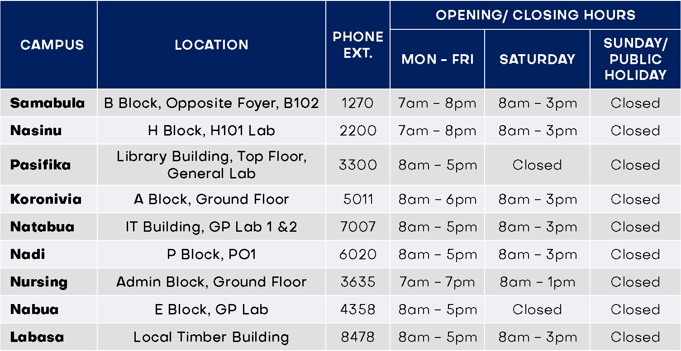
General Purpose ITS Labs
Details Location Extension
IT Service Desk Derrick Campus B217 1204/1205/1215

Slide 23
ITS Lab Rules
Students must have VALID ID Cards before entering the lab.
No playing of music, games and videos in the Lab PCs.
No pornographic materials to be viewed.
Students are NOT allowed to eat or drink in the lab.
No grouping around a particular PC.
Scan your flash drive for Virus checks before accessing them in the Lab PCs.
No disruptive or disorderly behaviour.
Backup your work regularly in your flash drive. Do not use hard disk as a backup drive as this will delete information.
Users should not use other students account. Do not share Username and Password with others.
Students failing to comply will be asked to leave the Lab and if the behavior persists DISCIPLINARY ACTIONS will be taken.

Slide 24
itservicedesk@fnu.ac.fj
Mobile: 9103411 Landline: 3389216
or
Visit your site/campus IT Tech for Assistance
24

Slide 25
All the Best!!
from
TEAM IT SERVICES
25

Slide 26
DIVISION OF INFORMATION TECHNOLOGY SERVICES
Moodle guide
Password Reset Guide
26

Slide 27
MOODLE GUIDE
What is Moodle?
Moodle is FNU’s learning management system. Moodle stands for Modular Object Oriented
Dynamic Learning Environment. Don’t worry about what Moodle stands for. Just know that
it is an environment specially created for educators and learners like you to engage with
your course in a technologically meaningful way beyond the classroom. It is a popular
learning management system in educational institutions worldwide.
We are proud to offer this online learning space to you and we trust you will take full
advantage of what’s available in Moodle. All you need is a computer connected to the
internet.
Most FNU courses have a Moodle course page. When you enrol and you access Moodle, you
will see your courses listed. Moodle course pages offer lecture notes, presentations, and a
forum for course announcements from your lecturer. Other course pages also offer quizzes
to test your knowledge, discussion forums, chat sessions, and other useful resources to
support your learning.
Ready to explore Moodle? In the next sections, we’ll guide you through the first steps…

Slide 28
What do I need to access Moodle?
To access Moodle, you need a computer connected to the internet. The computer you use
must have a web browser such as Firefox or Google Chrome. Web browsers are software
that enables you to access the World Wide Web. On a computer they are icons that look like
this:
If you don’t have a computer with internet access at home or at work, you can access Moodle
at your local FNU Campus. You should be given a username and password to log in to Moodle
if you are properly enrolled as an FNU student. If you have not received this yet, please
contact the ICT staff at your local FNU Campus.

Slide 29
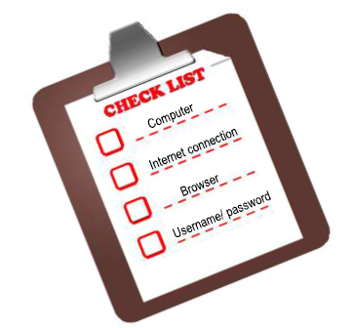
What do I need to access Moodle?
You can also access Moodle at FNU through a smart device such as a mobile phone, tablet, or laptop with an internet connection

Slide 30
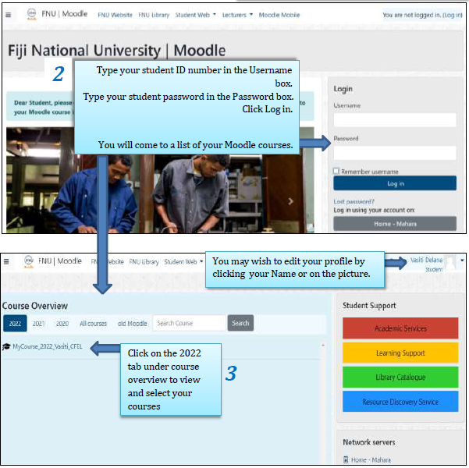
How do I log in to Moodle?
1

Slide 31
Exploring my Moodle course page
From 2022 onwards, you will have to login using your new banner student ID which starts
with an ‘A’, for example A00187929 and its associated password. If you would like to view
courses from previous years then you will have to login using your old student ID that starts
with ‘S’, for example S80808080 and its associated password. Contact itshelpdesk@fnu.ac.fj
for any login issues or course access queries.

Slide 32
Exploring my Moodle course page

Slide 33
Exploring my Moodle course page

Slide 34
Engaging with Moodle
What makes a successful online learner? Have a look at some tips for learning online.
Show up!
As an online learner, you get to choose when to do which online activities. It is your
responsibility to ‘show up’ in your online learning space.
Participate
To get the most of Moodle, make your ‘voice’ heard: ask questions and share your
ideas with others.
In Moodle, you and your lecturer can use forums, chats and email to discuss ideas,
ask or answer questions, learn from other learners’ perspectives, debate issues, give
feedback, or work in a group to present an assignment.
Online interaction is mostly through reading and writing. Having to write down ideas
or questions will make you a better learner; it clarifies thinking and deepens
understanding. Strengthening these skills will better prepare you for the workplace
of tomorrow.

Slide 35
Engaging with Moodle
Netiquette
As an online learner, you need to follow some rules for communicating online. This is called netiquette. Here are some rules to start with:
Introduce yourself in a meaningful way.
Post your messages in appropriate sections.
Be careful with jokes. Without your voice and body language, it is easy for
people to misinterpret.
Be critical of ideas but not of people.
Cite appropriate references. Plagiarism is an offence. If you are not sure how
to cite references, please contact your FNU library.
Online interaction works best when it happens in a trusting environment. You can help create such an environment!

Slide 36
Explore the Moodle tools
Now that you have some tips for learning online, let’s explore some basic Moodle tools.
Moodle has a variety of tools that you can use to undertake an online course. The tools are either ‘Resources’ or ‘Activities’. Resources are mainly content, while Activities are interactive.
The tools available in a Moodle course depends on what your teacher has enabled for presenting content and interaction. This may differ from course to course.
The Moodle tools have icons that look like this.

Slide 37
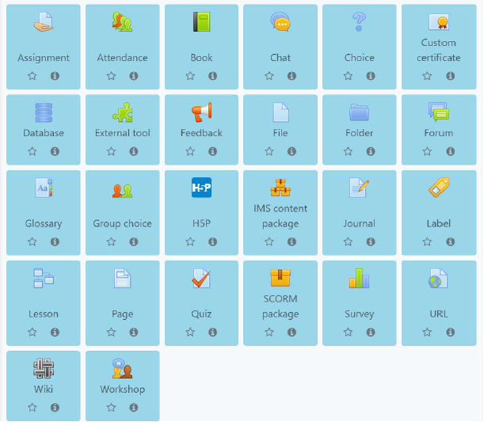
Explore the Moodle tools
The Moodle tools have icons that look like this.

Slide 38
The Text Editor
As a student engaging in online Moodle activities, you may be required to enter text, share images, links and other information when submitting assignments, posting to discussion forums or even answering quiz questions. The Text Editor in Moodle is available in all Moodle activities that require user input. There are various text editors available for use in Moodle, however FNU uses the Tiny MCE editor shown below.

Slide 39
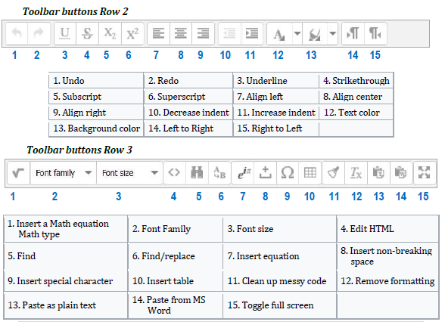

Slide 40
Forum
A forum is a place where you can post messages so that your whole class can read them. There are forums where you can only read and not post messages, for example, the ‘News’ forum where your lecturer posts important announcements about the course.
Generally, you can also read and reply to messages posted by others. Forums may be placed in various parts of the course page depending on your course. Forums are useful for you to share your ideas about a topic with other students in your course. Participation is key here if you would like an enriching experience in Moodle!

Slide 41
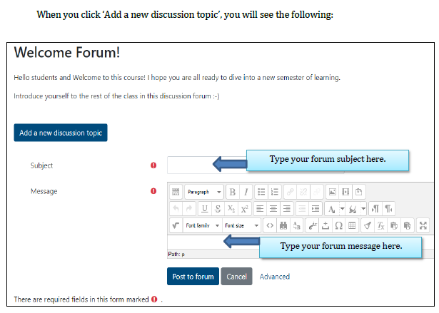

Slide 42
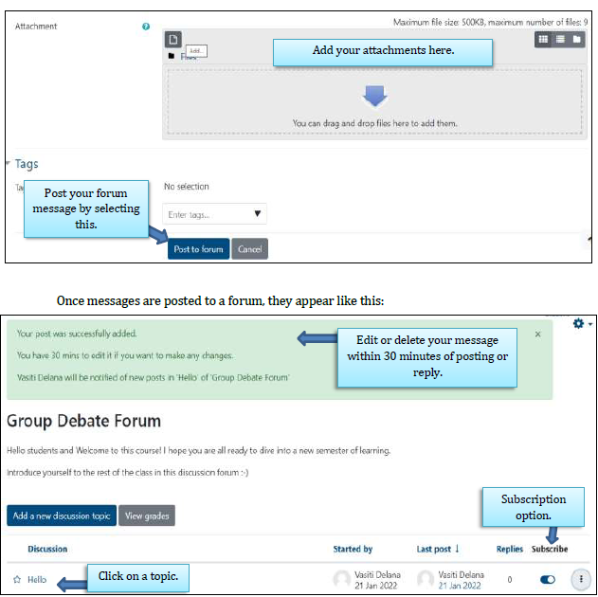
When you click on advanced link , the page above will expand to include the following:

Slide 43
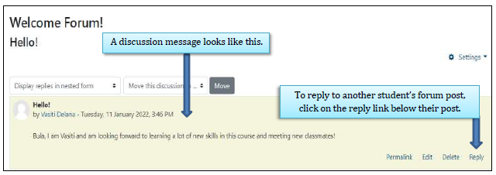

Slide 44
Assignment
Assignments are a vital part of any course. They allow you to demonstrate what you have learnt in your course and are used to assess your progress. At FNU you will come across many different types of assignments.
Moodle allows you to keep track of assignments in your course so that you can see what you have completed and what is left for you to do. Your lecturer can provide feedback for the assignments that you submit in Moodle. By using Moodle to keep track of your assignments, you can reduce the chance of falling behind in your course work.
In Moodle, your lecturer may require you to submit your assignment in the following ways:
1. Uploading assignments by writing and submitting inside Moodle. Moodle will provide you with a text input area to write your assignment and then submit it once completed.
Or
2. Uploading assignment files that you have created offline (outside Moodle). You will need to have these files saved on your computer or external device.

Slide 45
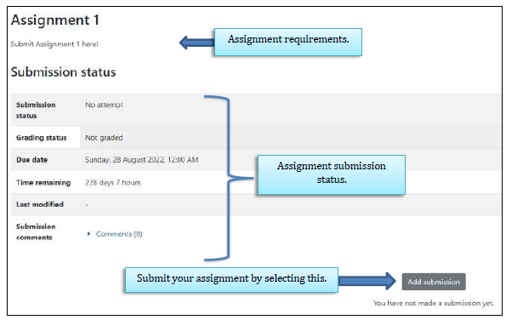
It is possible for you to submit drafts of your assignments before submitting your final version. This depends on whether your lecturer enables this in Moodle.
When you click on an assignment link in your course, you will see the following:

Slide 46
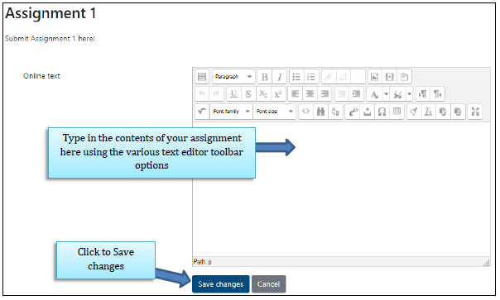
If you are required to submit online text, then the text editor below will appear.

Slide 47
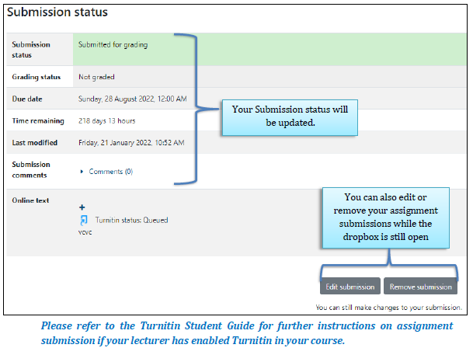

Slide 48
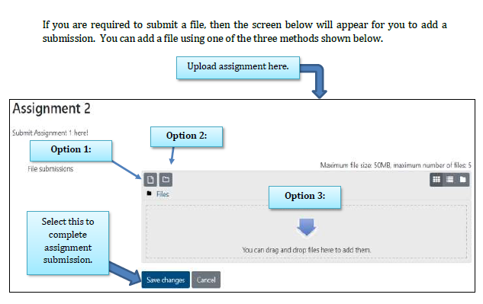
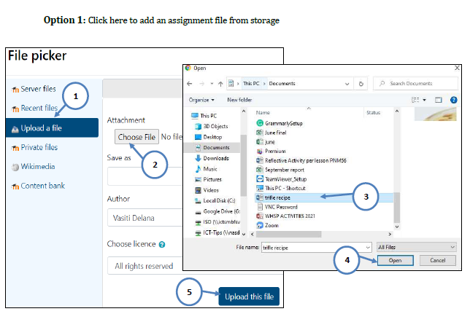

Slide 49
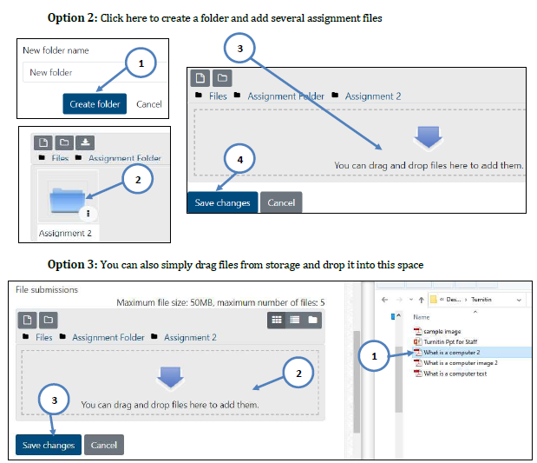

Slide 50
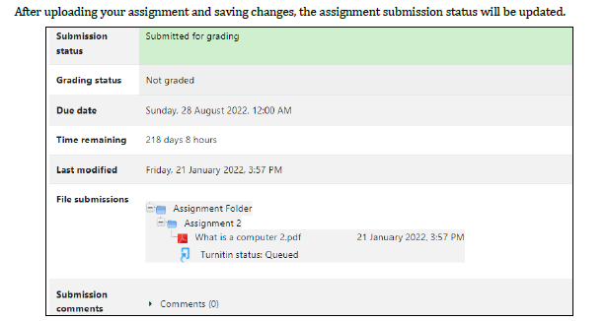

Slide 51
Quiz
The Moodle Quiz tool allows you to attempt online tests or quizzes containing various
question types prepared by the teacher. The teacher also determines the quiz settings which
control the quiz availability dates, the duration of attempts, the number of attempts allowed
and the quiz review options.
Quizzes may be used:
As course exams;
As mini tests for reading assignments or at the end of a topic;
As exam practice using questions from past exams;
To deliver immediate feedback about performance; or
For self-assessment.
As a student, it is important that you are well aware of any upcoming Quizzes and its related
information so you can prepare properly for the test in terms of studying and also the
devices you will need to attempt the quiz like a tablet or laptop and internet connection.

Slide 52
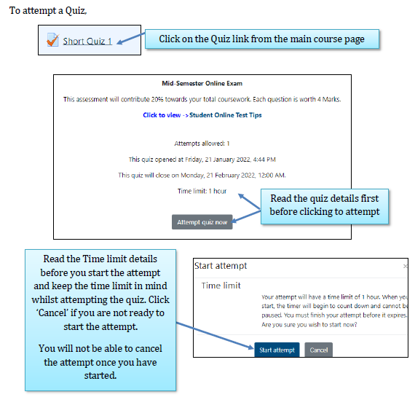

Slide 53
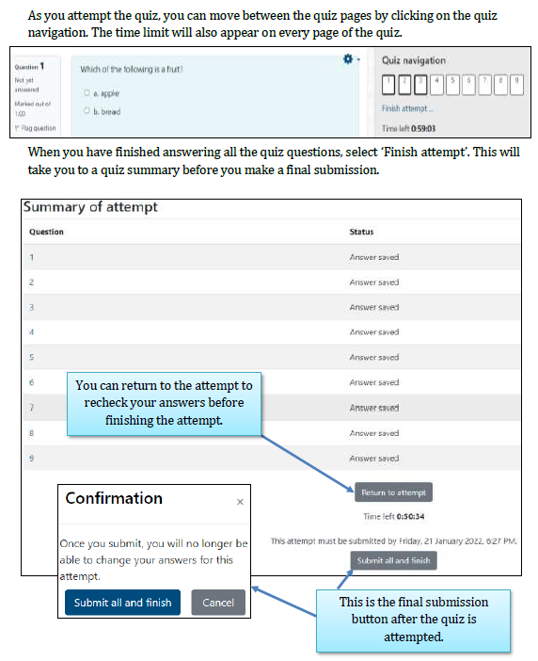

Slide 54
If enabled in the quiz settings, you will be able to view your quiz results and reports after you submit the quiz attempt.
For more information and tips to prepare for an online quiz or test, download a copy of ‘Online Test Tips for Students’.

Slide 55
Practice Moodle tools
Access this demo course as a mock student (’Barbara Gardener’) to familiarize yourself with some of the Moodle tools:
https://school.moodledemo.net/mod/page/view.php?id=46
The demo course groups the Moodle tools into various categories: Access, Participate, Assessment and Evaluation, Collaborate and Communicate.

Slide 56
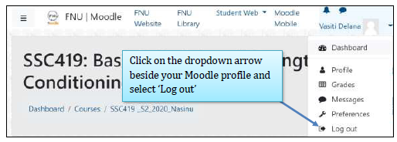
How do I logout of Moodle?
Always remember to logout of Moodle from every device that you use to prevent unauthorized users from accessing your Moodle account.
Please note that students cannot ‘Hack’ into another student’s Moodle account. Unauthorized users can only access your Moodle account if you have shared your login details or if you forget to logout of Moodle from the devices you have been using. Hence, it is very important to always logout of Moodle after every session and also keep your login details confidential.

Slide 57
Where do I get more Moodle help?
You may experience various issues when using Moodle; from not being able to log in, to using Moodle tools. The first point of contact should be your local FNU Campus ICT Helpdesk.
You can also email: itshelpdesk@fnu.ac.fj or lt-cfel@fnu.ac.fj
A Moodle FAQ (Frequently Asked Questions) resource for FNU students is available here:
https://elearn.fnu.ac.fj/mod/glossary/view.php?id=381612
Additional resources
As more good practice guides become available, you will be notified by adfel@fnu.ac.fj or cfel@fnu.ac.fj

Slide 58
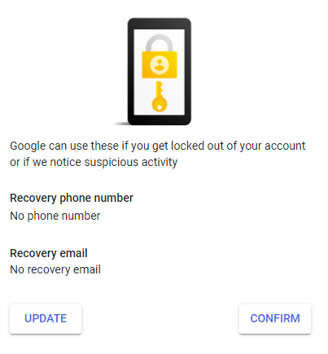
Student Email Password Registration
When you receive your username and password, please register yourself for password recovery verification
Click on update
For Recovery Phone Number

Slide 59
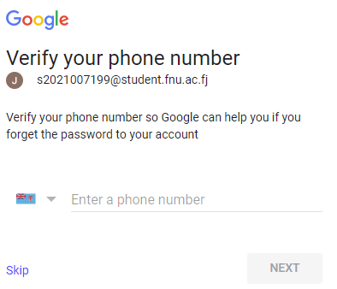
Enter Mobile Number and click Next

Slide 60
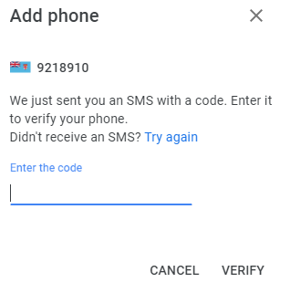
Enter the Verification Code that you receive on you mobile and click Verify

Slide 61
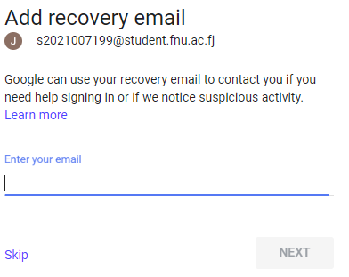
For Recovery Email
Enter email address and click Next
You will receive an email code. Enter the code and click on Verify

Slide 62
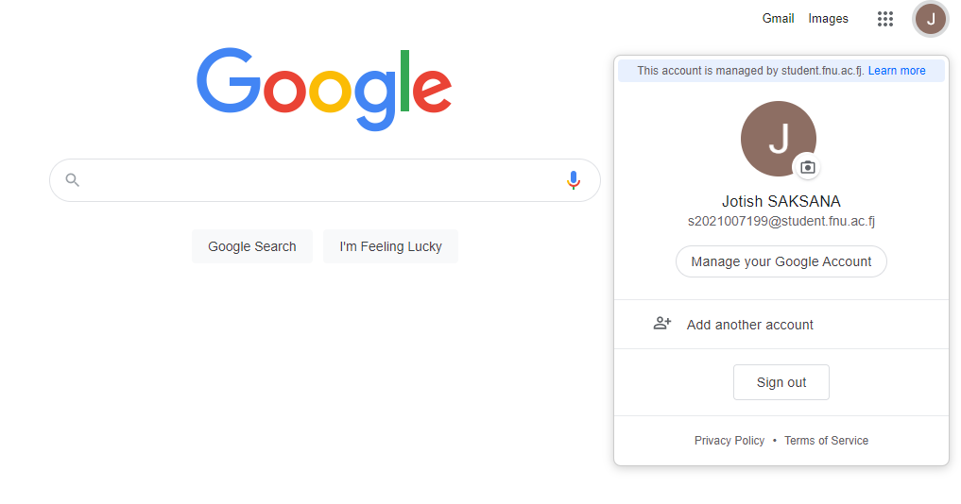
To check or Modify your recovery Details Login to student Gmail account and click on Manage your Google account

Slide 63
Click on Security and scroll to Ways we can verify it’s you. You will see your details that you can modify

Slide 64
Student Email Password Reset Guide
If you have lost or forgotten your student email password, you can use this guide to reset your password
Go to www.google.com and click on Gmail

Slide 65
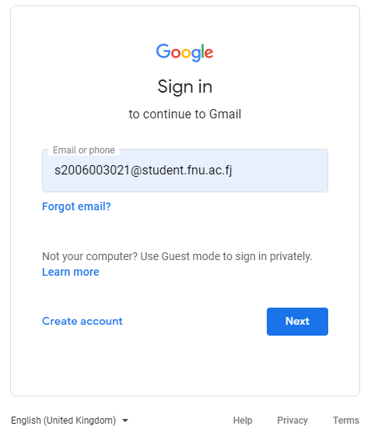
2. Enter your student email address and click on Next

Slide 66
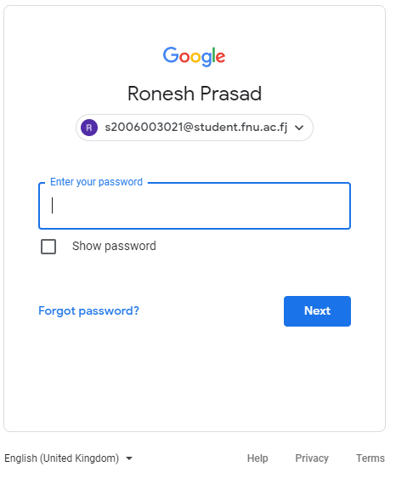
3. On the next page click on Forgot Password and click on Next

Slide 67
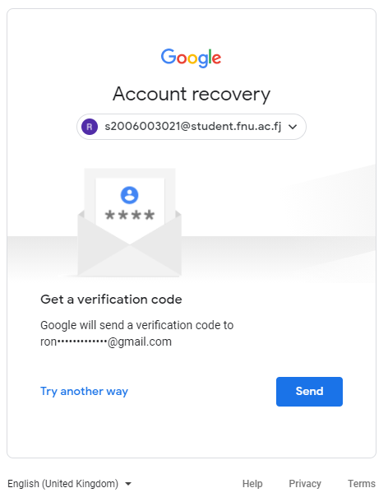
If you have given a primary email address and verified that’s the correct email address click on send to receive a temporary password in that’s not the email address you can click on Try another way

Slide 68
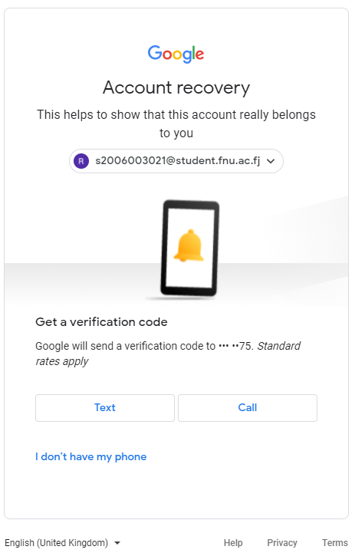
5. This will ask you to verify the mobile number that has been provided into the system, if the number is correct then you can choose to either get a call or a text to get a code to enable you to get a password

Slide 69
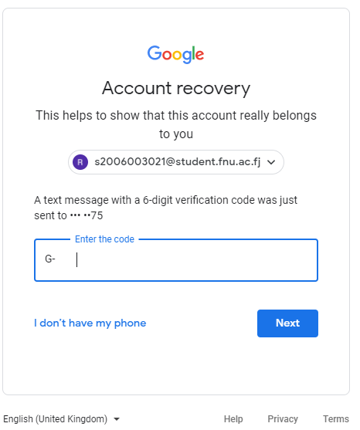
6. The code that you receive on your phone you will have to enter into the code area provided

Slide 70
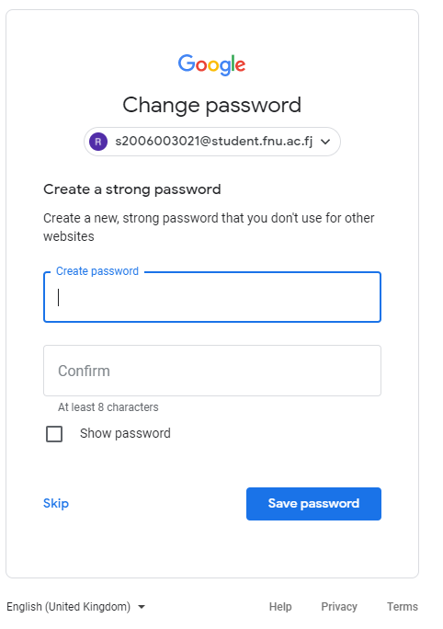
7. Then you will be required to change your password

Slide 71
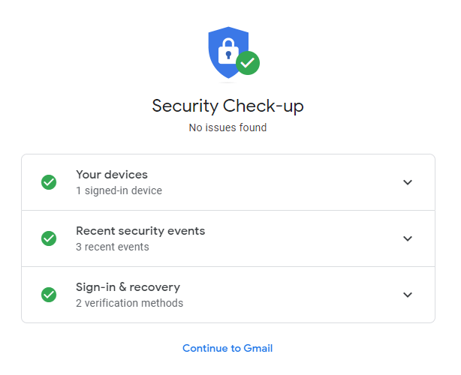
8. Verify the security check-up and click on continue to Gmail to go to your mailbox

Slide 72
Student Password – How to change
Students can access the Password change page from www.fnu.ac.fj / student

Slide 73
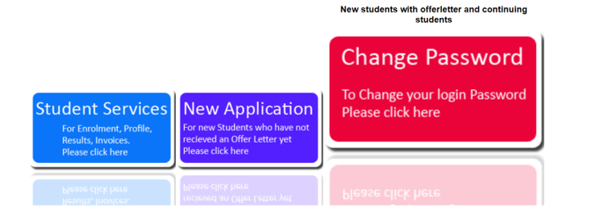
Student Password – How to change
Students can reset both the PC/Weblearn – Moodle Login and Student Banner passwords from the FNU Website.
Link:https://services.fnu.ac.fj/sms/

