Slide 1
EndNote
Online EndNote Training for HDR Candidates
Office of the Pro Vice Chancellor – Research
The Fiji National University

Slide 2
Introduction
EndNote is a reference management program that allows you to create, store and manage your references and citations.
Reference information can be added manually, and/or imported from article databases and catalogues.
The records stored in your personal EndNote Library can be used to create bibliographies instantly in a variety of bibliographic styles, and citations can be inserted into Word documents.
You can also put PDF documents or other files into your EndNote Library

Slide 3
Creating EndNote Library
Watch How to Use EndNote in Six Minutes
https://www.youtube.com/watch?v=7e6-6QkcYm0
Copy and paste the above link to the browser

Slide 4
Creating Endnote Library
EndNote should always be opened from the start button, and not via Word.
Saving a copy of your Library is useful if you want to take it with you to access on another computer. It is also important to have only one EndNote library. It is recommended using a local drive to save.
Open the EndNote program from your Programs list.
Select File/New.
Name your new Library and choose where you want to save It.* (EndNote may default to saving it in your My Documents folder).
Your new Library will appear on your screen.

Slide 5
Create a copy of your Library
With a library open, go to the File menu and select Save a Copy.
Enter a name and location for your new File
Click Save
Make a note of where you saved your Library

Slide 6
Back-Up Your Libraries
You can choose where to save the backup.
You may want to save it to the same place that you keep backups of documents
You work on to establish a routine where your library backup at the same time as you backup other documents.
It is recommended to have just one library.
Problems may occur if you cite from different libraries in one Word-document
You can use the Save a Copy command to save a copy of your Library for safekeeping

Slide 7
The Library Window
When you first open a library, there are three different panes:
Groups Panel: Displays subsets of references from your Library such as custom groups, etc.
Reference list panel: Displays all individual references on a single line.
Reference panel: Has tabs for common tasks

Slide 8
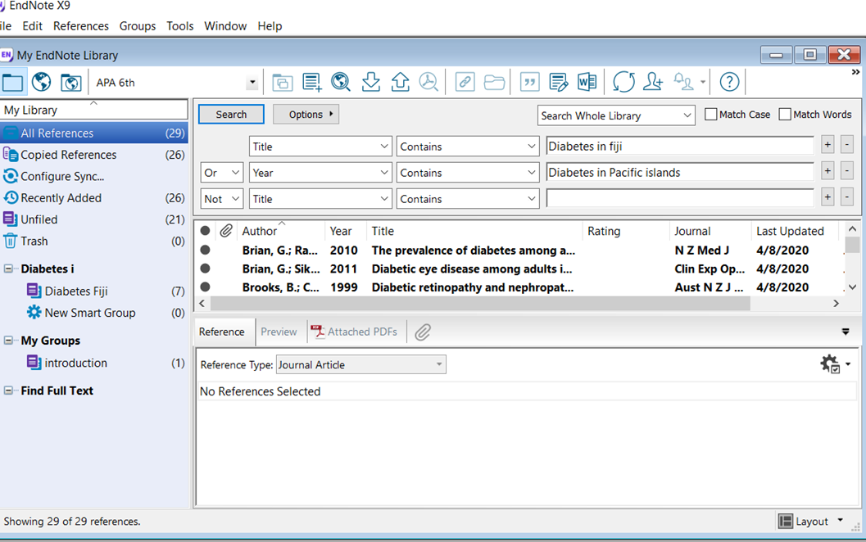
Note: Click on the layout icon at the bottom right of the window to change the layout

Slide 9
Navigating the Reference list
There are a number of ways to browse through your references:
You can quickly sort the references by clicking on a column heading. For example, click Year to sort by year.
Typing a letter selects the first matching reference.
The HOME and END keys go to the first or last reference, respectively.

Slide 10
Searching and grouping within Endnote
Layout

Slide 11
The Groups Panel
There are several types of groups including Permanent, Temporary, and Custom Groups.
Deleting a reference from a Custom Group does not delete it from the Library.
Deleting a reference from a library also removes it from a group

Slide 12
Permanent groups include:
All References: Displays all of the references in the current Library.
Recently added: Contains references which have been recently added.
Unfiled: Contains any references in your Library that have not been allocated to a group.
Trash: Contains the references you have removed from the Library by highlighting references and selecting Move References to Trash. While the references are no longer in your Library, they are not completely deleted until you go to the Groups menu and select Empty Trash.

Slide 13
Temporary groups include:
Copied References: Using the copy and paste commands to transfer references.
Duplicate References: Displays the results of duplicate detection in your Library.
Imported References: Displays the last set of references imported into the Library with the File>Import command, or through direct Export from a database.
Search Results: Displays the most recent search results.
Note: Temporary groups are deleted when a library is closed. Also, these temporary groups may be replaced as you use commands in EndNote.

Slide 14
Customs Group Custom Groups make it easy to break a large library into subsets for later viewing. | From the Groups menu choose Create Group. Give your group a name and press Enter. Alternatively, right-click on My Groups in the My Library pane and choose Create Group. There are several ways to add records to a group; highlight the record(s) then use the drag & drop method to move the reference(s) to the appropriate group, or from the Group menu choose Add References To and select the relevant group
Smart Groups SmartGroupshaveaninbuiltsearchqueryandcandynamicallyupdateasyouaddandeditreferencesinthe Library. | From the Groups menu, select Create Smart Group. At these arch dialoging era name for the group, a search strategy, and select Create.
Combination Groups Combination Groups used better organize EndNote references. Combine groups and use AND, OR, and NOT to create new, use fulsmart groups. Save references in groups and then save sets of groups in group sets | From the Groups menu, select Create From Groups At the search dialog enter a name for the group, a search strategy, and select Create

Slide 15
Group Sets
The Group set creates several groups, within one larger group. Group Sets can contain Custom Groups, Smart Groups, and Combination Groups.
From the Groups menu, select Create Group Set. Name your Group Set

Slide 17
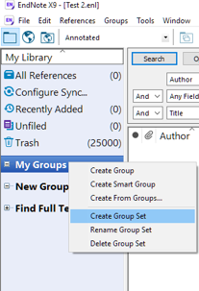
Right-click on My Groups in the My Library pane and choose Create Group Set. You can then drag and drop groups into it.

Slide 18
Opening and Closing Libraries
Opening a Library
From EndNote’s File menu select Open Library.
Locate your Library and click Open.
Closing a Library
Choose Close Library from the File menu.
End Note automatically saves your Custom Groups and style preferences. Closing a library does not quit the EndNote program. The best way to protect yourself from damaged files is to regularly backup your Library

Slide 19
Choosing the preferred referencing style
References in your EndNote Library can be formatted in various bibliographic styles. The style presents what the in-text citations and bibliographies are to look like when completed
On the main toolbar, click Edit, then Output Styles then select a new style from the list.
Click on a style to select it.

Slide 20
Choose the preferred style here

Slide 21
Importing full-text PDFs into your Endnote Library
You can import a PDF file or a folder of PDFs directly to your Library. EndNote automatically creates the reference for you when you import the PDF(s).
In your EndNote Library, go to File then scroll down to Import, selecting File.
Select Choose, and then find the PDF file you want to import.
From the Import Option drop-down menu select PDF, and then select Import.
To import a batch of PDFs, go to File then Import, and select Folder instead of File.
If you have sub-folders containing PDF files, ensure you select include files in subfolders before
Clicking Import.
You can import a PDF file or a folder of PDFs directly to your Library.

Slide 22
Searching Endnote Library
Quick Search
To quickly search your entire Library, use the Quick Search item on the main toolbar.
Enter a word or phrase and press Enter.
To redisplay the contents of your entire EndNote Library: Select, References > Show All References

Slide 23
Type a word/phrase and press Enter

Slide 24
Deleting References
Select (highlight) those references you want to delete.
One of the following actions moves the selected references to the Trash group:
Drag the selected references and drop them on the Trash group.
From the References menu, choose Move References to Trash (CTRL+D).
From the Edit menu, choose Cut (CTRL+X), which also stores the references temporarily on the Clipboard.
When certain to delete the references in the Trash, go to the References menu and choose Empty Trash.

Slide 25
Importing references from the databases into Endnote
Three methods enable you to import references:
Direct Exporting
Filter Files
Connection Files
Direct Exporting from FNU databases
Direct Exporting of references from a database into an EndNote library is the quickest and easiest method.

Slide 26
Example 1: Science Direct
Log in as (FNU staff/students) to save your search results
Perform search and select the information to Export
Select Export from top of search results
Select Export citation to RIS format (for EndNote) to download the File
Click on the File to automatically import it into EndNote. The references will automatically add to a temporary group, Imported References

Slide 28
Example 2: EBSCO Host Super-package
Login as a registered user to save your search results.
Perform your search and mark your records by clicking on the Add to folder (folder icon) alongside each citation.
Click on the Folder icon in the header menu.
Select your records and click on the Export link.

Slide 29
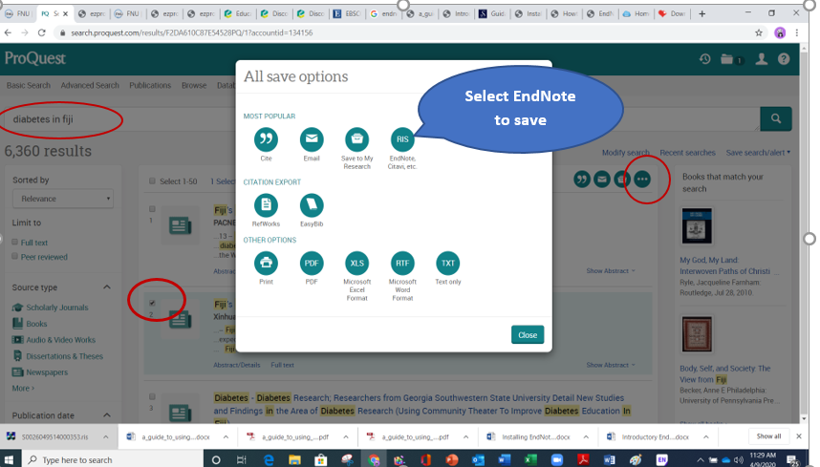
Example 3: ProQuest Central and ProQuest EBook Central
Log in into the database as a student/staff of FNU
Perform the required search and click on folders

Slide 30
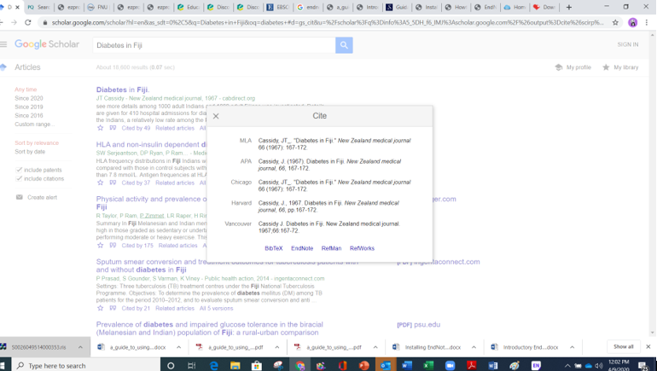
Example 4: Using Google Scholar to perform a search and import into EndNote
1.Search from the Google Scholar page
2.Select the “quotation mark“import EndNote
3. Select EndNote to export references

Slide 31
Manually adding references to the Library
Open your EndNote library.
Go to References
New Reference, or click this button:
Choose the correct reference type:

Slide 33
Inserting in-text citations using Microsoft work
EndNote has a feature called ‘Cite While You Write’, which starts creating bibliographies as soon as you insert your first citation into a Word document. Word 2016 has an EndNote tab that allows you to work between your Word document and the references in your EndNote library.

Slide 34
Appropriate referencing style according to the requirements
In Word, click the EndNote X9 tab at the top of the screen to see the styles
In the Bibliography section at the top of your screen, click the drop-down menu next to Style and select

Slide 35
Select referencing style

Slide 36
Inserting In-Text Citations in word document
Open a new word document with some text.
Click the cursor to a place where would like the citation to appear
Click the EndNote X9 tab at the top of the screen to see the EndNote options in Word
Click Go to EndNote to switch to the EndNote library you have open. Highlight a reference of your choice
Click on Insert Citation from the options at the top of your screen (quotation marks).

Slide 37
Click here for creating bibliography

Slide 38
Creating bibliography
Word and EndNote automatically format the references you add, inserting a bibliography at the end of your document. If new citations added to your text are not automatically appearing in your bibliography, click on the Instant formatting drop-down menu and select Turn instant formatting on.
If the references in your bibliography do not look correct, it may be that the information is wrong in your EndNote library. To fix this:
Go into your EndNote library and double click on the relevant reference
Manually edit the reference in your EndNote library
Go back to your Word document, select the EndNote X9 tab and, from the Bibliography box, select Update Citations and Bibliography

Slide 39
Related training videos
https://www.youtube.com/watch?v=8KTDSl9OGgE
https://libguides.rutgers.edu/endnotetutorials/EndNoteX9
https://www.youtube.com/watch?v=7e6-6QkcYm0
https://www.youtube.com/watch?v=GC0paEPQixg
Cut and paste the above links on the browser for additional training.

Slide 40
References
Clarivate Analytics (2018). The Little EndNote How-To Book. Available online from http://clarivate.libguides.com/ld.php?content_id=42104347
FNU (2020). EndNote Library Guide. The Library Resource Center. Fiji National University, Suva.
Contact Person
For further information please contact:
EO-PVCR
Office of the Pro Vice Chancellor - Research
Fiji National University
Ph: +679 3394 000 Ext: 2043

